Slide 1
Sentimental Analysis on IMDB Dataset
Submitted By:
Zubayer Bin Rashid - 1782
Mohiuddin Tamim - 1763
Ami Biswas - 1400
Submitted To:
Faisal Ahmed
Assistant Professor
Premier University Chittagong

Slide 2





Experiment Results
Literature Review
Methodology
Conclusion
Introduction

Slide 3



Introduction
Background
Sentimental analysis on movie review
Motivation
Objective
Assume a review is good or bad from dataset of reviews
Train computer to assume that a movie is good or not by learning from reviews.

Slide 4
Background
Sentiment analysis, commonly referred to as opinion mining, examines how people feel about various objects, including goods, services, groups of people, organizations, topics, events, and their characteristics
Sentiment analysis of IMDB movie reviews is the process of determining how the general public feels about a particular film and how they will evaluate it
Text mining, Natural Language Processing (NLP), and other computational methods are used in sentiment analysis.

Slide 5
Motivation
Sentiment analysis of a movie review can rate how positive or negative a movie review is and hence the overall rating for a movie
The process of understanding if a review is positive or negative can be automated as the machine learns through training and testing the data
The main purpose of a movie review is to inform the reader about the film and its ideas.

Slide 6

Objective
The aim of the project is to determine the attitude of the reviewer with respect to various topics or the overall polarity of review
We used tokenization, word filtering, stemming, text representation, and classifications that all play a vital role to reach the aim of this project. For text representation, TF-IDF model is used.
To examine the performance like accuracy, recall, precision, F1 score of different machine learning classifiers (Naive Bayes, K-Nearest Neighbor Classifier (KNN), Decision Tree, and Logistic Regression) are used.

Slide 7

Literature Review
No | Paper Name | Authors | Data source | Classifiers used | Accuracy | Limitation
01 | Sentiment Analysis of IMDb Movie Reviews Using Long Short-Term Memory | Saeed Mian Qaisar | Created by Andrew Maas | Long Short-Term memory classifier | 89.9% | Higher classification accuracy can be achieved by employing the ensemble classifiers or deep learning approaches
02 | Movies Reviews Sentiment Analysis and Classification | Mais Yasen Sara Tedmor | IMDB | Naive Bayes Decision Tree Support Vector Classifier Bayes Network K-nearest Neighbors Random Forest | 96.01% | Authors wish to experiment with different SA methods in order to increase the accuracy of the results

Slide 8
Literature Review Continued
No | Paper Name | Authors | Data source | Classifiers used | Accuracy | Future Works
03 | Sentiment Analysis of IMDB Movie Reviews | Abhimanyu Singh Chaitanya Kulkarni Necati A. Ayan | Created by Abdalraouf Hassan and Ausif Mahmood | Naïve Bayes Logistic Regression Support Vector Machine | 86.89% | A comparison of the performance analysis of deep learning Algorithms will be conducted to improve the accuracy of the models
04 | Sentiment Analysis For Movies Reviews Dataset Using Deep Learning Models | Nehal Mohamed Ali Marwa Mostafa Abd El Hamid Aliaa Youssif | IMDB | Convolutional Neural Network Long Short-Term Memory Recursive Neural Tensor Networks | 89.20% | Conduct a similar study on different languages

Slide 9






Methodology
Proposed Method
Dataset Description
Preprocessing
Text Representation
Classification

Slide 10
Proposed Method
Preprocessing:
Removing special characters
Case conversion
Stop words removal
Lemmatization
Dataset
Training Data
Split Dataset
Feature Extraction Using TF-IDF
Test Data
Classification model NB, LR, KNN, DT
Result

Slide 11

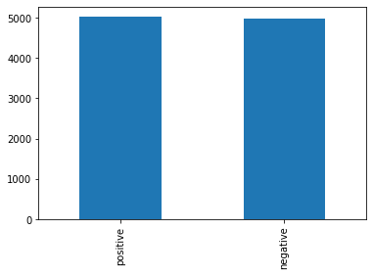
Dataset Description
Dataset was extracted from Kaggle and it was created by Laksh-mipathi N.
In the dataset, we acquired two types of sentiments positive and negative. The positive sentiments are 5028 in number and negative sentiments are 4972 in number.
Dataset Distribution
Fig-1: Kaggle Logo
Fig-2: Dataset Distribution

Slide 12
Pre-processing
Removing special characters: special characters like (exclamation points and question marks) are eliminated
Case Conversion: provides a simpler classification of the sentiments in this proposed system
Stop word removal: Stop words are absurd words. So they are removed
Lemmatization: It is a process of converting the given word to its root word.

Slide 13

Text Representation
A common method for weighing terms in NLP tasks is called TF-IDF (term frequency-inverse document frequency. A robust feature selection strategy called Term Frequency-Inverse Document Frequency extracts key words from textual data. Here,
Term Frequency(TF): Number of times a word appears in a document (raw count)
Inverse Document Frequency(IDF): Inverse document frequency looks at how common (or uncommon) a word is amongst the corpus
$$TF=\frac{Frequency of a particular word in a document}{Total number of unique words in the document}$$
$$IDF=\frac{Total no of documents}{Documents with a particular term}$$
$$TF−IDF=TF ∗IDF$$

Slide 14



Classification
01
Logistic Regression Classifier
Naive Bayes Classifier
04
02
Decision Tree Classifier
K-Nearest Neighbor Classifier
03

Slide 15
Experiments and Results
Libraries used in the python project:
Pandas: Pandas is a python library. We used it for data analysis as well as manipulation
NumPy: NumPy is a Python Library used for working with arrays. We used numpy as it offers high performance multidimensional arrays and basic tools for computing operations and manipulate these arrays
Sklearn: It provides a selection of efficient tools for machine learning and statistical modeling including classification, regression, clustering and dimensionality reduction via a consistence interface in Python
Matplotlib: Matplotlib is a comprehensive library for creating static, animated, and interactive visualizations in Python.

Slide 16


Experiments and Results Continued
Coding platform and toolkit used in the python project:
Colaboratory, or “Colab” for short, is a product from Google Research. Colab allows anybody to write and execute arbitrary python code through the browser, and is especially well suited to machine learning, data analysis and education.
Fig-3: Colab Logo
The Natural Language Toolkit, or more commonly NLTK, is a suite of libraries and programs for symbolic and statistical natural language processing (NLP) for English written in the Python programming language.
Fig-4: NLTK Logo

Slide 17
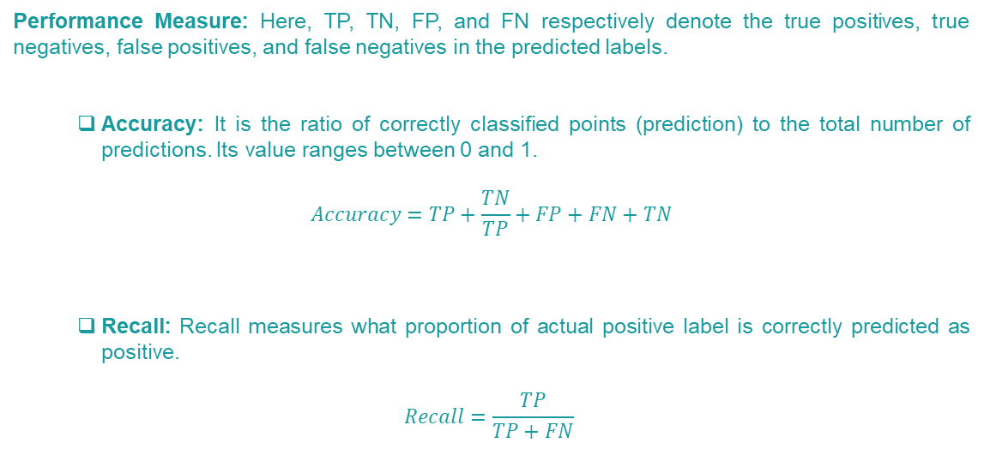
Experiments and Results Continued
Performance Measure: Here, TP, TN, FP, and FN respectively denote the true positives, true negatives, false positives, and false negatives in the predicted labels.
Accuracy: It is the ratio of correctly classified points (prediction) to the total number of predictions. Its value ranges between 0 and 1.
$$Accuracy=TP+\frac{TN}{TP}+FP+FN+TN$$
Recall: Recall measures what proportion of actual positive label is correctly predicted as positive.
$$Recall=\frac{TP}{TP+FN}$$

Slide 18
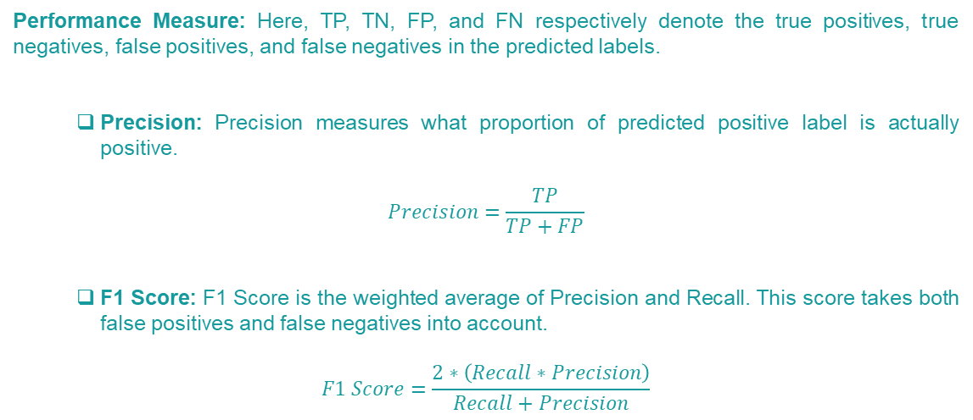
Experiments and Results Continued
Performance Measure: Here, TP, TN, FP, and FN respectively denote the true positives, true negatives, false positives, and false negatives in the predicted labels.
Precision: Precision measures what proportion of predicted positive label is actually positive.
$$Precision=\frac{TP}{TP+FP}$$
F1 Score: F1 Score is the weighted average of Precision and Recall. This score takes both false positives and false negatives into account.
$$F1 Score=\frac{2∗\left(Recall∗Precision\right)}{Recall+Precision}$$

Slide 19
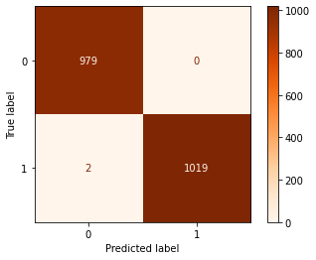
Experiments and Results Continued
Naïve Bayes Classifier
Reviews | Precision | Recall | F1-Score | Accuracy
Positive | 0.61 | 0.65 | 0.63 | 0.6295
Negative | 0.65 | 0.61 | 0.63
Naïve Bayes Classifier gave us almost 62% accuracy.
Fig-5: NB Confusion Matrix

Slide 20
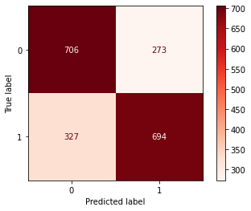
Experiments and Results Continued
k-Nearest Neighbor Classifier
Reviews | Precision | Recall | F1-Score | Accuracy
Positive | 0.68 | 0.72 | 0.70 | 0.7
Negative | 0.72 | 0.68 | 0.70
k-Nearest Neighbor Classifier gave us 70% accuracy.
Fig-6: KNN Confusion Matrix

Slide 21
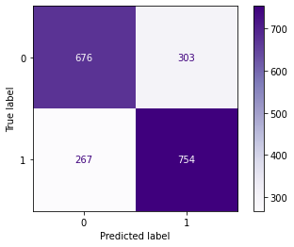
Experiments and Results Continued
Decision Tree Classifier
Reviews | Precision | Recall | F1-Score | Accuracy
Positive | 0.72 | 0.69 | 0.70 | 0.715
Negative | 0.71 | 0.74 | 0.73
Decision Tree Classifier gave us almost 72% accuracy.
Fig-7: DT Confusion Matrix

Slide 22
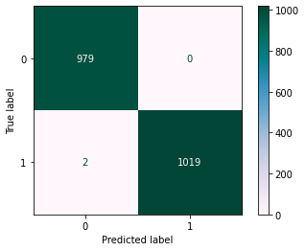
Experiments and Results Continued
Logistic Regression Classifier
Reviews | Precision | Recall | F1-Score | Accuracy
Positive | 0.67 | 0.67 | 0.67 | 0.8
Negative | 0.86 | 0.86 | 0.86
Logistic Regression Classifier gave us almost 80% accuracy.
Fig-8: LR Confusion Matrix

Slide 23
Experiments and Results Continued
Result Comparison of the Classifiers
Classifier | Reviews | Precision | Recall | F1-Score | Accuracy
Naive Bayes | Positive | 0.61 | 0.65 | 0.63 | 0.6295
 | Negative | 0.65 | 0.61 | 0.63
k-Nearest Neighbor | Positive | 0.68 | 0.72 | 0.70 | 0.7
 | Negative | 0.72 | 0.68 | 0.70
Decision Tree | Positive | 0.72 | 0.69 | 0.70 | 0.715
 | Negative | 0.71 | 0.74 | 0.73
Logistic Regression | Positive | 0.67 | 0.67 | 0.67 | 0.8
 | Negative | 0.86 | 0.86 | 0.86

Slide 24
Experiments and Results Continued
Classifiers that work best for our model:
 | Classifiers |  |  | Accuracy
01 | Logistic Regression |  | 80%
02 | Decision Tree |  | 71%
03 | k-Nearest Neighbor |  | 70%

Slide 25
Conclusion
We came up with a model which helps us to find out the sentimental analysis from IMDB movie reviews. We extracted the recall, precision, f1 score and accuracy of 80%.
Limitations:
We worked with small dataset due to hardware limitation
Our model cannot work with the reviews that are in other languages
We did not use bag of words or Word2Vec with gensim for vectorizing the dataset, so we do not know whether it will give better results than TF-IDF.
Future Work:
Conduct a similar study on different languages specially on Bangla language
Use deep learning techniques to improve the accuracy of the prediction.

Slide 26
Thank you
for your valuable time

